Slide 1
Control, Change, and Entrepreneurship
Chapter Eight

Slide 2
Learning Objectives
LO8-1 Define organizational control, and identify the main output and behavior controls managers use to coordinate and motivate employees
LO8-2 Describe the four steps in the control process and the way it operates over time.
LO8-3 Identify the main output controls, and discuss their advantages and disadvantages as means of coordinating and motivating employees.

Slide 3
Learning Objectives
LO8-4 Explain how clan control or organizational culture creates an effective organizational architecture
LO8-5 Discuss the relationship between organizational control and change, and explain why managing change is a vital management task
LO8-6 Understand the role of entrepreneurship in the control and change process

Slide 4
What is Organizational Control?
Controlling
Process where managers monitor and regulate how efficiently and effectively an organization and its members are performing the activities necessary to achieve organizational goals

Slide 5
Control Systems and IT
Control Systems
Formal, target-setting, monitoring, evaluation and feedback systems that provide managers with information about how well the organization’s strategy and structure are working
Notes:
A control system contains the measures that allow managers to assess how efficiently the organization is producing goods and services
Without a control system in place, managers have no idea how well their organization is performing and how its performance can be improved

Slide 6
Control Systems
A good control system should:
be flexible so managers can respond as needed
provide accurate information about the organization
provide information in a timely manner

Slide 7
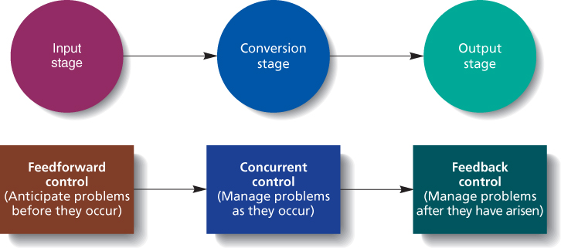
Three Types of Control
Figure 8.1

Slide 8
Question?
What type of control gives managers information about customers’ reactions to goods and services?
Feedforward Control
Concurrent Control
Feedback Control
Benchmark Control
Notes:
The answer is “C” – feedback control. See slide 8-13.

Slide 9
Types of Control
Feedforward Control
Control that allows managers to anticipate problems before they arise
Concurrent Control
Give managers immediate feedback on how efficiently inputs are being transformed into outputs so that managers can correct problems as they arise

Slide 10
Types of Control
Feedback Control
Control that gives managers information about customers’ reactions to goods and services so that corrective action can be taken if necessary

Slide 11
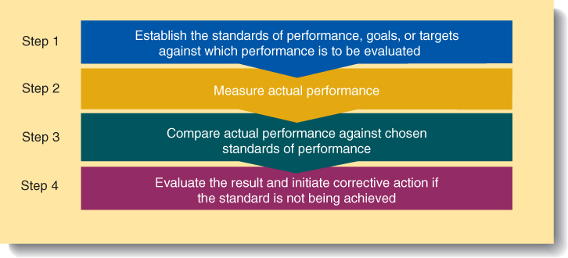
Four Steps in Organizational Control
Figure 8.2
Notes:
Establish standards, goals, or targets against which performance is to be evaluated
Standards must be consistent with the organization’s strategy
Measure actual performance
Managers can measure outputs resulting from worker behavior or they can measure the behavior themselves.
Compare actual performance against chosen standards
Managers must decide if performance actually deviates, often, several problems combine creating low performance
Evaluate the result and initiate corrective action if the situation is not being achieved
Standards have been set too high or too low.
Workers may need additional training or equipment.
This step is often hard since the environment is constantly changing.

Slide 12
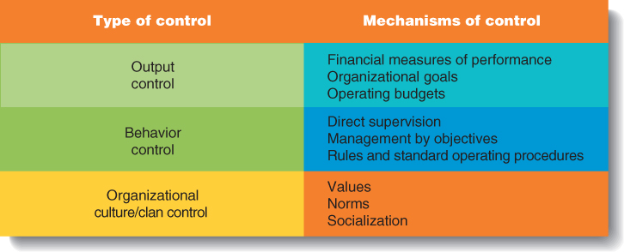
Three Organizational Control Systems
Figure 8.3

Slide 13
Discussion Question
What is an example of financial control? How are financial controls used?
Activity drivers
Revenue ratios
Liquidity ratios
Net income budget
Notes:
The correct answer is “C” – Liquidity ratios.
Profit ratios
Measures of how efficiently managers convert resources into profits —return on investment (ROI).
Liquidity ratios
Measures of how well managers protect resources to meet short term debt—current and quick ratios.
Leverage ratios
Measures of how much debt is used to finance operations—debt-to-asset and times-covered ratios.
Activity ratios
Measures of how efficiently managers are creating value from assets—inventory turnover, days sales outstanding ratios.

Slide 14
Financial Measures of Performance
Profit ratios
Measures of how efficiently managers convert resources into profits
return on investment (ROI).
Liquidity ratios
Measures of how well managers protect resources to meet short term debt—current and quick ratios.

Slide 15
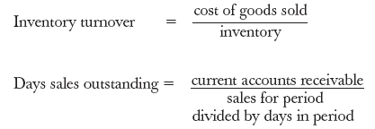
Financial Measures of Performance
Leverage ratios
Measures of how much debt or equity is used to finance operations—debt-to-asset and times-covered ratios.
Activity ratios
Measures of how efficiently managers are creating value from assets—inventory turnover, days sales outstanding ratios.

Slide 16
Organizational Goals
Goals should be specific and difficult
Stretch goals
goals that challenge and stretch managers’ ability but are not out of reach and do not require an impossibly high expenditure of managerial time and energy.
Notes:
Organizational Goals
Each division within the firm is given specific goals that must be met in order to attain overall organizational goals.

Slide 17
Organization-Wide Goal Setting
Figure 8.4

Slide 18
Operating Budgets
Operating Budget
A blueprint that states how managers intend to allocate and use the resources they control to attain organizational goals effectively and efficiently
Lower-level managers are evaluated for their ability to stay within the budget and to make the best use of available resources
Notes:
Managers are evaluated by how well they meet goals for controlling costs, generating revenues, or maximizing profits while staying within their budgets.

Slide 19
Operating Budgets
Three components are the essence of effective output control
Objective financial measures
Challenging goals and performance standards
Appropriate operating budgets

Slide 20
Problems with Output Control
Managers must create output standards that motivate at all levels.
Standards should not cause managers to behave in inappropriate ways to achieve organizational goals

Slide 21
Direct Supervision
Managers who:
Actively monitor and observe the behavior of their subordinates
Teach subordinates the behaviors that are appropriate and inappropriate
Intervene to take corrective action as needed

Slide 22
Management by Objectives
Management by Objectives (MBO)
A goal-setting process in which managers and subordinates negotiate specific goals and objectives for the subordinate to achieve and then periodically evaluate their attainment of those goals
Notes:
Specific goals are set at each level of the firm.
Goal setting is participatory with manager and worker
Periodic reviews of subordinates’ progress toward goals are held (pay raises and promotions are tied to goal attainment).
Teams are also measured in this way with goals and performance measured for the team.

Slide 23
Management by Objectives
Specific goals and objectives are established at each level of the organization
Managers and their subordinates together determine the subordinates’ goals
Managers and their subordinates periodically review the subordinates’ progress toward meeting goals

Slide 24
Bureaucratic Control
Bureaucratic Control
Control of behavior by means of a comprehensive system of rules and standard operating procedures.
Notes:
Rules and SOPs tell the worker what to do (standardized actions) so outcomes are predictable.
There is still a need for output control to correct mistakes.
Bureaucratic control is best used for routine problems in stable environments.

Slide 25
Bureaucratic Control
Problems with Bureaucratic Control
Rules easier to make than discarding them, leading to bureaucratic “red tape” and slowing organizational reaction times to problems
Firms become too standardized and lose flexibility to learn, to create new ideas, and solve to new problems

Slide 26
Organizational Culture
Organizational Culture
The shared set of beliefs, expectations, values, norms, and work routines that influences how members of an organization interact with one another and work together to achieve organizational goals

Slide 27
Organizational Culture
Clan Control
Control exerted on individuals and groups in an organization by shared values, norms, standards of behavior, and expectations

Slide 28
Adaptive vs. Inert Culture
Adaptive Culture
Culture whose values and norms help an organization to build momentum and to grow and change as needed to achieve its goals and be effective
Inert Culture
Culture that leads to values and norms that fail to motivate or inspire employees
Leads to stagnation and often failure over time

Slide 29
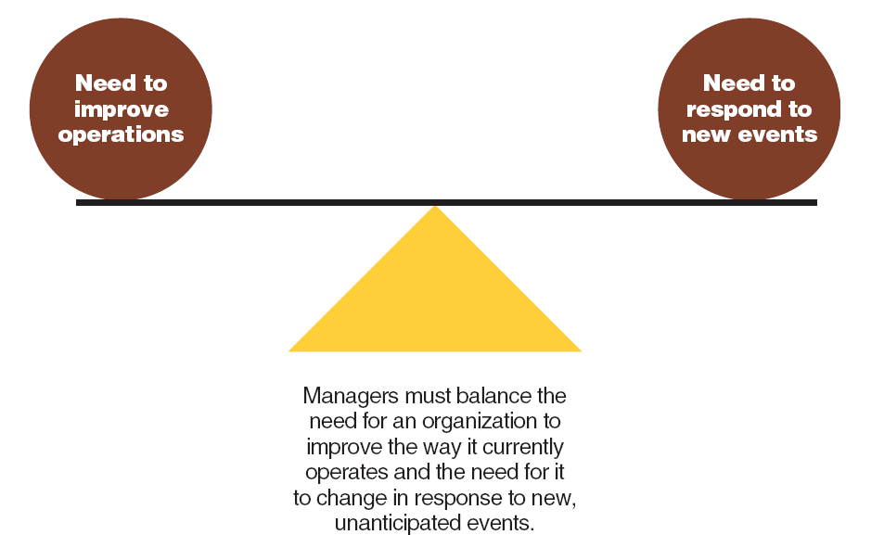
Organizational Control and Change
Figure 8.5

Slide 30
Organization Change
Organization Change
Movement of an organization away from its present state and toward some desired future state to increase its efficiency and effectiveness

Slide 31
Four Steps in the Organizational Change Process
Figure 8.6

Slide 32
Organization Change
Organizational Learning
Process through which managers try to increase organizational members’ abilities to understand and appropriately respond to changing conditions
Impetus for change
Can help members make decisions about changes

Slide 33
Organization Change
Top-down change
A fast, revolutionary approach to change in which top managers identify what needs to be changed, decide what to do, and then move quickly to implement changes throughout the organization

Slide 34
Organization Change
Bottom-up change
A gradual or evolutionary approach to change in which managers at all levels work together to develop a detailed plan for change

Slide 35
Question?
What is the process of comparing one company’s performance on specific dimensions with the performance of other high performance organizations?
Financial comparison
Objective benching
Benchmarking
Competitor analysis
Notes:
The answer is “C” – benchmarking. See slide 8-36.

Slide 36
Organization Change
Benchmarking
Process of comparing one company’s performance on specific dimensions with the performance of other high performance organizations

Slide 37
Entrepreneurship, Control, and Change
Entrepreneurs
People who notice opportunities and take responsibility for mobilizing the resources necessary to produce new and improved goods and services
Notes:
Entrepreneur Success
An entrepreneur must hire managers who can create an operating and control system that will let a new venture survive and prosper

Slide 38
Entrepreneurship, Control, and Change
Intrapreneurs
employees of existing organizations who notice opportunities for product or service improvements and are responsible for managing the development process

Slide 39
Entrepreneurship, Control, and Change
Entrepreneurship
Mobilization of resources to take advantage of an opportunity to provide customers with new or improved goods and services

Slide 40
Video: Manufacturing
Can America thrive without manufacturing jobs?
What should be combined with labor costs? Why?

